Slide 1
SQL Statements
SELECT DISTINCT column1, column2, ...
FROM table_name;
The following SQL statement selects only the DISTINCT values from the "Country" column in the "Customers" table.
SELECT DISTINCT Country FROM Customers;
The following SQL statement lists the number of different (distinct) customer countries
SELECT COUNT(DISTINCT Country) FROM Customers;

Slide 2
SQL Statements
The SQL ORDER BY Keyword
The ORDER BY keyword is used to sort the result-set in ascending or descending order.
The ORDER BY keyword sorts the records in ascending order by default. To sort the records in descending order, use the DESC keyword.
SELECT column1, column2, ...
FROM table_name
ORDER BY column1, column2, ... ASC|DESC;

Slide 3
SQL Statements
The SQL ORDER BY Keyword
The following SQL statement selects all customers from the "Customers" table, sorted by the "Country" column.
SELECT * FROM Customers ORDER BY Country;

Slide 4
SQL Statements
SQL NULL Values
A field with a NULL value is a field with no value.
If a field in a table is optional, it is possible to insert a new record or update a record without adding a value to this field. Then, the field will be saved with a NULL value.
It is not possible to test for NULL values with comparison operators, such as =, <, or <>.
We will have to use the IS NULL and IS NOT NULL operators instead.

Slide 5
SQL Statements
SQL NULL Values
SELECT column_names
FROM table_name
WHERE column_name IS NULL;
SELECT column_names
FROM table_name
WHERE column_name IS NOT NULL;

Slide 6
SQL Statements
SQL UPDATE Statement
The UPDATE statement is used to modify the existing records in a table.
UPDATE table_name
SET column1 = value1, column2 = value2, ...
WHERE condition;

Slide 7
SQL Statements
SQL UPDATE Statement
The UPDATE statement is used to modify the existing records in a table.
UPDATE table_name
SET column1 = value1, column2 = value2, ...
WHERE condition;
UPDATE Customers
SET ContactName = 'Alfred Schmidt', City= 'Frankfurt'
WHERE CustomerID = 1;

Slide 8
SQL Statements
SQL UPDATE Statement
UPDATE Multiple Records
UPDATE Customers
SET ContactName=‘Ram'
WHERE Country=‘USA’;
Update Warning!
Be careful when updating records. If you omit the WHERE clause, ALL records will be updated!

Slide 9
SQL Statements
SQL MIN() and MAX() Functions
The MIN() function returns the smallest value of the selected column.
The MAX() function returns the largest value of the selected column.
SELECT MIN(column_name)
FROM table_name
WHERE condition;
SELECT MAX(column_name)
FROM table_name
WHERE condition;

Slide 10
SQL Statements
SQL MIN() and MAX() Functions
SELECT MIN(Price) AS SmallestPrice
FROM Products;
SELECT MAX(Price) AS LargestPrice
FROM Products;

Slide 11
SQL Statements
SQL COUNT(), AVG() and SUM() Functions
The COUNT() function returns the number of rows that matches a specified criterion.
SELECT COUNT(column_name)
FROM table_name
WHERE condition;
The AVG() function returns the average value of a numeric column.
SELECT AVG(column_name)
FROM table_name
WHERE condition;

Slide 12
SQL Statements
SQL COUNT(), AVG() and SUM() Functions
The SUM() function returns the total sum of a numeric column.
SELECT SUM(column_name)
FROM table_name
WHERE condition;
Note: NULL values are not counted/are ignored.

Slide 13
SQL Statements
SQL Aliases
SQL aliases are used to give a table, or a column in a table, a temporary name.
Aliases are often used to make column names more readable.
An alias only exists for the duration of that query.
An alias is created with the AS keyword.

Slide 14
SQL Statements
SQL Aliases
Alias Column Syntax
SELECT column_name AS alias_name
FROM table_name;
SELECT CustomerID AS ID, CustomerName AS Customer
FROM Customers;

Slide 15
SQL Statements
SQL Aliases
Alias Table Syntax
SELECT column_name(s)
FROM table_name AS alias_name;
SELECT o.OrderID, o.OrderDate, c.CustomerName
FROM Customers AS c, Orders AS o
WHERE c.CustomerName='Around the Horn' AND c.CustomerID=o.CustomerID;
SELECT Orders.OrderID, Orders.OrderDate, Customers.CustomerName
FROM Customers, Orders
WHERE Customers.CustomerName='Around the Horn' AND Customers.CustomerID=Orders.CustomerID;

Slide 16
SQL Statements
The SQL GROUP BY Statement
The GROUP BY statement groups rows that have the same values into summary rows, like "find the number of customers in each country".
The GROUP BY statement is often used with aggregate functions (COUNT(), MAX(), MIN(), SUM(), AVG()) to group the result-set by one or more columns.
SELECT column_name(s)
FROM table_name
WHERE condition
GROUP BY column_name(s)
ORDER BY column_name(s);

Slide 17
SQL Statements
The SQL GROUP BY Statement
The following SQL statement lists the number of customers in each country:
SELECT COUNT(CustomerID), Country
FROM Customers
GROUP BY Country;
The following SQL statement lists the number of customers in each country, sorted high to low:
SELECT COUNT(CustomerID), Country
FROM Customers
GROUP BY Country
ORDER BY COUNT(CustomerID) DESC;

Slide 18
SQL Statements
The SQL HAVING Clause
The HAVING clause was added to SQL because the WHERE keyword cannot be used with aggregate functions.
SELECT column_name(s)
FROM table_name
WHERE condition
GROUP BY column_name(s)
HAVING condition
ORDER BY column_name(s);

Slide 19
SQL Statements
The SQL HAVING Clause
The following SQL statement lists the number of customers in each country. Only include countries with more than 5 customers:
SELECT COUNT(CustomerID), Country
FROM Customers
GROUP BY Country
HAVING COUNT(CustomerID) > 5;
The following SQL statement lists the number of customers in each country, sorted high to low (Only include countries with more than 5 customers):
SELECT COUNT(CustomerID), Country
FROM Customers
GROUP BY Country
HAVING COUNT(CustomerID) > 5
ORDER BY COUNT(CustomerID) DESC;

Slide 20
Foreign Key
Tables are related to other tables with a primary key foreign key relationship.
Primary and foreign key relationships are used in relational databases to define many-to-one relationships between tables.
A FOREIGN KEY is a field (or collection of fields) in one table, that refers to the PRIMARY KEY in another table.
The table with the foreign key is called the child table(referencing table), and the table with the primary key is called the referenced or parent table.

Slide 21
Foreign Key

Slide 22
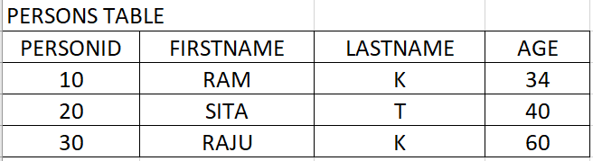
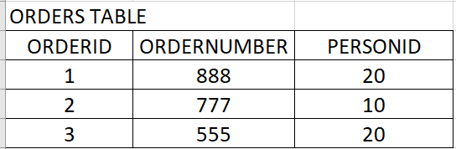
Foreign Key
Notice that the "PersonID" column in the "Orders" table points to the "PersonID" column in the "Persons" table.
The "PersonID" column in the "Persons" table is the PRIMARY KEY in the "Persons" table.
The "PersonID" column in the "Orders" table is a FOREIGN KEY in the "Orders" table.
The FOREIGN KEY constraint prevents invalid data from being inserted into the foreign key column, because it has to be one of the values contained in the parent table.

Slide 23
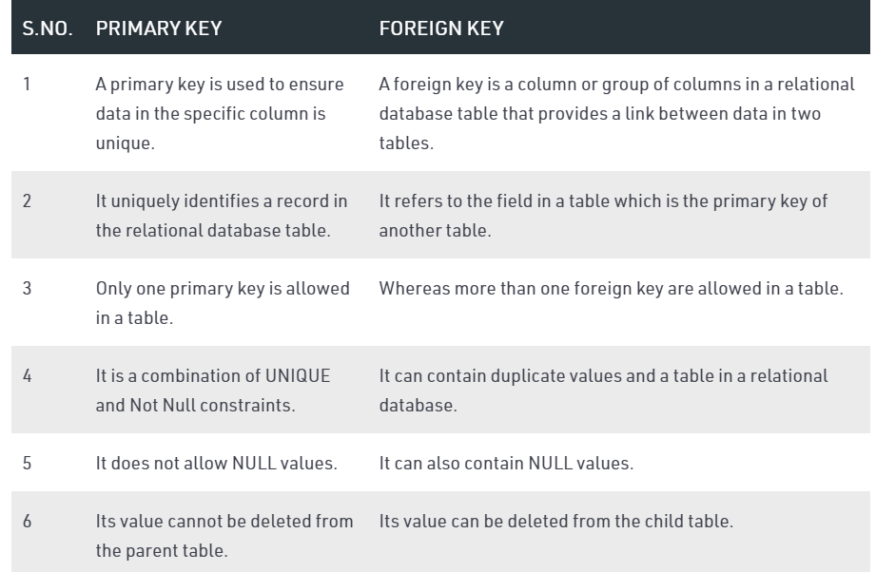
Foreign Key

Slide 24
Foreign Key
CREATE TABLE Persons (
PersonID int ,
Firstname varchar(20),
Lastname varchar(20),
Age int,
PRIMARY KEY (PersonID));
CREATE TABLE Orders (
OrderID int,
OrderNumber int NOT NULL,
PersonID int,
PRIMARY KEY (OrderID),
FOREIGN KEY (PersonID) REFERENCES Persons(PersonID)
);

Slide 25
Foreign Key
CREATE TABLE Orders (
OrderID int NOT NULL,
OrderNumber int NOT NULL,
PersonID int,
PRIMARY KEY (OrderID),
CONSTRAINT FK_PersonOrder FOREIGN KEY (PersonID)
REFERENCES Persons(PersonID)
);

Slide 26
Foreign Key
ALTER TABLE Orders
ADD FOREIGN KEY (PersonID) REFERENCES Persons(PersonID);
ALTER TABLE Orders
ADD CONSTRAINT FK_PersonOrder
FOREIGN KEY (PersonID) REFERENCES Persons(PersonID);
ALTER TABLE Orders
DROP FOREIGN KEY FK_PersonOrder;

Slide 27
Foreign Key
ALTER TABLE Orders
ADD FOREIGN KEY (PersonID) REFERENCES Persons(PersonID);
ALTER TABLE Orders
ADD CONSTRAINT FK_PersonOrder
FOREIGN KEY (PersonID) REFERENCES Persons(PersonID);
ALTER TABLE Orders
DROP FOREIGN KEY FK_PersonOrder;

